Slide 1


Name: Chandan R batch: 2021-7233 trainer: SV Karthik enrollment number: ebeon0322577951

Slide 2
Online Payments Fraud Detection with Machine Learning

Slide 3

objective
The introduction of online payment systems has helped a lot in the ease of payments.
But, at the same time, it increased in payment frauds. Online payment frauds can happen with anyone using any payment system, especially while making payments using a credit card.

Slide 4
To identify online payment fraud with machine learning, we need to train a machine learning model for classifying fraudulent and non-fraudulent payments. For this, we need a dataset containing information about online payment fraud, so that we can understand what type of transactions lead to fraud.

Slide 5
CoLUMNS
step: represents a unit of time where 1 step equals 1 hour
type: type of online transaction
amount: the amount of the transaction
nameOrig: customer starting the transaction
oldbalanceOrg: balance before the transaction
newbalanceOrig: balance after the transaction
nameDest: recipient of the transaction
oldbalanceDest: initial balance of recipient before the transaction
newbalanceDest: the new balance of recipient after the transaction
isFraud: fraud transaction
1. step: represents a unit of time where 1 step equals 1 hour
2. type: type of online transaction
3. amount: the amount of the transaction
4. nameOrig: customer starting the transaction
5. oldbalanceOrg: balance before the transaction
6. newbalanceOrig: balance after the transaction
7. nameDest: recipient of the transaction
8. oldbalanceDest: initial balance of recipient before the transaction
9. newbalanceDest: the new balance of recipient after the transaction
10. isFraud: fraud transaction

Slide 6
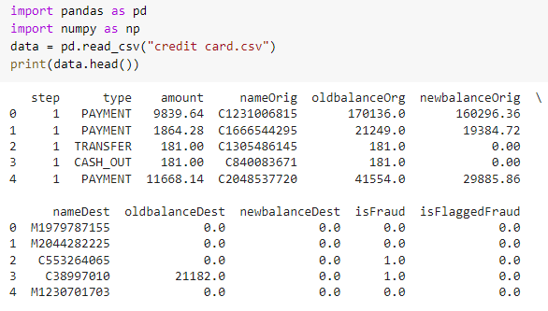
Output
Milestone 1
Planning
Initial Investment
Milestone 2
Second Investment
Returns
Communication

Slide 7
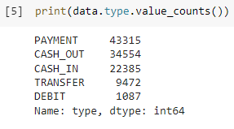
type of transaction mentioned in the dataset
step: represents a unit of time where 1 step equals 1 hour
type: type of online transaction
amount: the amount of the transaction
nameOrig: customer starting the transaction
oldbalanceOrg: balance before the transaction
newbalanceOrig: balance after the transaction
nameDest: recipient of the transaction
oldbalanceDest: initial balance of recipient before the transaction
newbalanceDest: the new balance of recipient after the transaction
isFraud: fraud transaction

Slide 8
type of transaction mentioned in the dataset
step: represents a unit of time where 1 step equals 1 hour
type: type of online transaction
amount: the amount of the transaction
nameOrig: customer starting the transaction
oldbalanceOrg: balance before the transaction
newbalanceOrig: balance after the transaction
nameDest: recipient of the transaction
oldbalanceDest: initial balance of recipient before the transaction
newbalanceDest: the new balance of recipient after the transaction
isFraud: fraud transaction

Slide 9
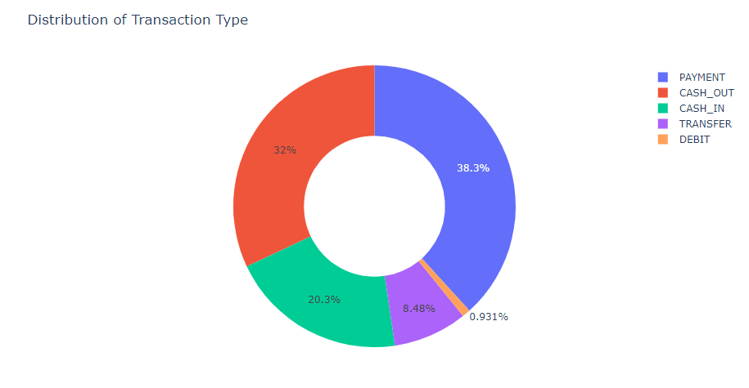
type of transaction mentioned in the dataset
step: represents a unit of time where 1 step equals 1 hour
type: type of online transaction
amount: the amount of the transaction
nameOrig: customer starting the transaction
oldbalanceOrg: balance before the transaction
newbalanceOrig: balance after the transaction
nameDest: recipient of the transaction
oldbalanceDest: initial balance of recipient before the transaction
newbalanceDest: the new balance of recipient after the transaction
isFraud: fraud transaction

Slide 10
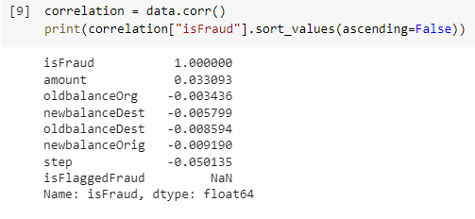
# Checking correlation
step: represents a unit of time where 1 step equals 1 hour
type: type of online transaction
amount: the amount of the transaction
nameOrig: customer starting the transaction
oldbalanceOrg: balance before the transaction
newbalanceOrig: balance after the transaction
nameDest: recipient of the transaction
oldbalanceDest: initial balance of recipient before the transaction
newbalanceDest: the new balance of recipient after the transaction
isFraud: fraud transaction

Slide 11

# splitting the data
step: represents a unit of time where 1 step equals 1 hour
type: type of online transaction
amount: the amount of the transaction
nameOrig: customer starting the transaction
oldbalanceOrg: balance before the transaction
newbalanceOrig: balance after the transaction
nameDest: recipient of the transaction
oldbalanceDest: initial balance of recipient before the transaction
newbalanceDest: the new balance of recipient after the transaction
isFraud: fraud transaction

Slide 12
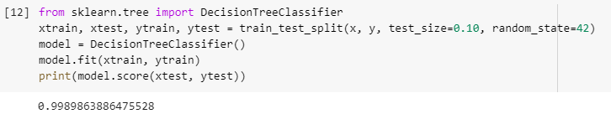
# training a machine learning model
step: represents a unit of time where 1 step equals 1 hour
type: type of online transaction
amount: the amount of the transaction
nameOrig: customer starting the transaction
oldbalanceOrg: balance before the transaction
newbalanceOrig: balance after the transaction
nameDest: recipient of the transaction
oldbalanceDest: initial balance of recipient before the transaction
newbalanceDest: the new balance of recipient after the transaction
isFraud: fraud transaction

Slide 13

prediction
step: represents a unit of time where 1 step equals 1 hour
type: type of online transaction
amount: the amount of the transaction
nameOrig: customer starting the transaction
oldbalanceOrg: balance before the transaction
newbalanceOrig: balance after the transaction
nameDest: recipient of the transaction
oldbalanceDest: initial balance of recipient before the transaction
newbalanceDest: the new balance of recipient after the transaction
isFraud: fraud transaction

Slide 14

Thank you

